Slide 1

DeckTechCentral
Week 5 Report

Slide 2
What have we done so far?
Created a solid front-end that is ready for execution
Defined OpenAPI spec
Setup our MongoDB
Started implementing OAuth

Slide 3
Setbacks
Our main setback was our lack of familiarity with MongoDB and OAuth. We spent more time studying how to use the software than we expected on our Gantt Chart.
UI resizing - while we work on our front-end, we tried to pick up the pace so we could have more time learning and using the new software for the back-end. We did not take in consideration the possibility for the user to change the size of the windows, or to be on a mobile device, so we had to focus more on responsive resizing and rearranging of the window.

Slide 4
Setbacks
We also needed to rewrite some of our code as we were learning it to allow reusability.

Slide 5
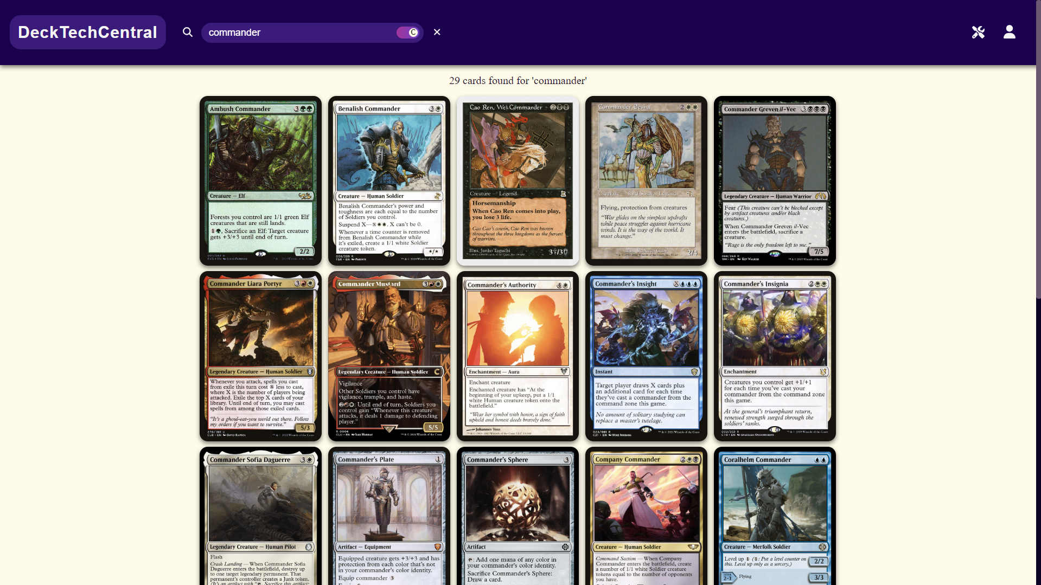
Card List View

Slide 6
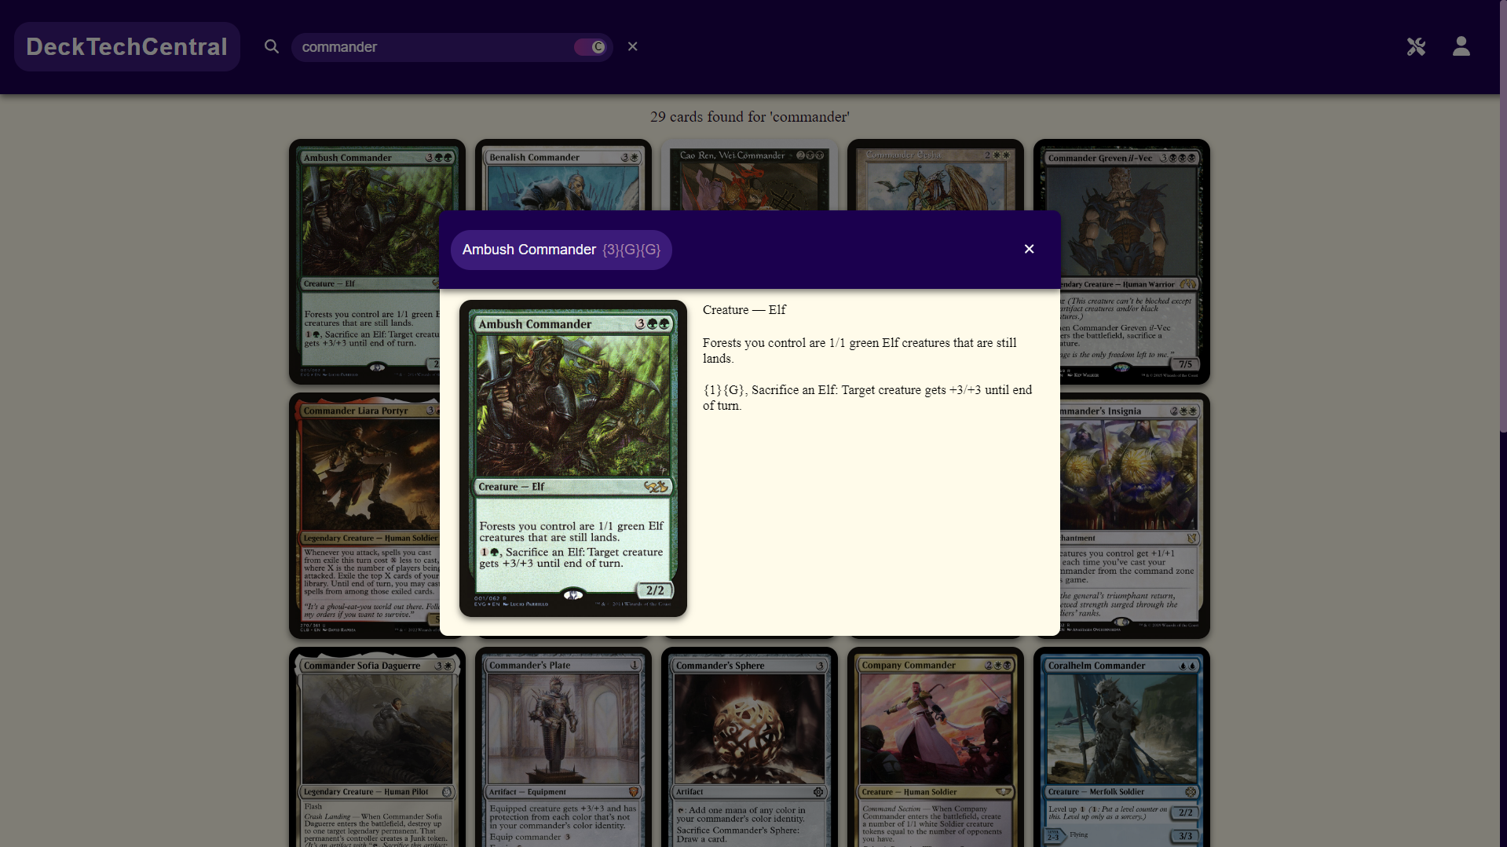
Card Modal View

Slide 7
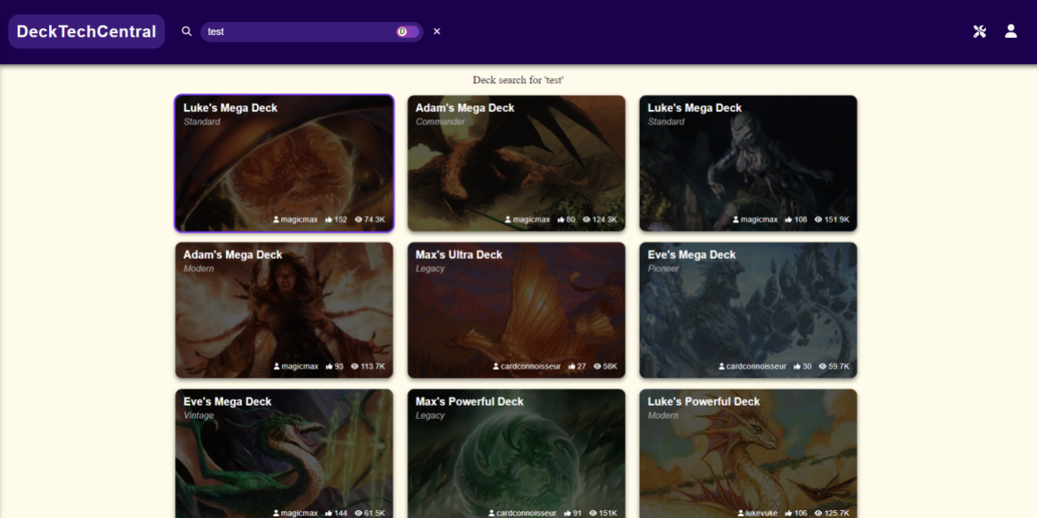
Deck List View

Slide 8
OAuth, Scryfall
By implementing OAuth, we can now sign in using a Google account.
We used Scryfall in order to create our database that will be automatically updated when new cards come out.

Slide 9
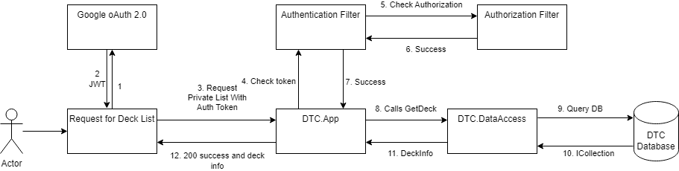
API Dataflow Example

Slide 10
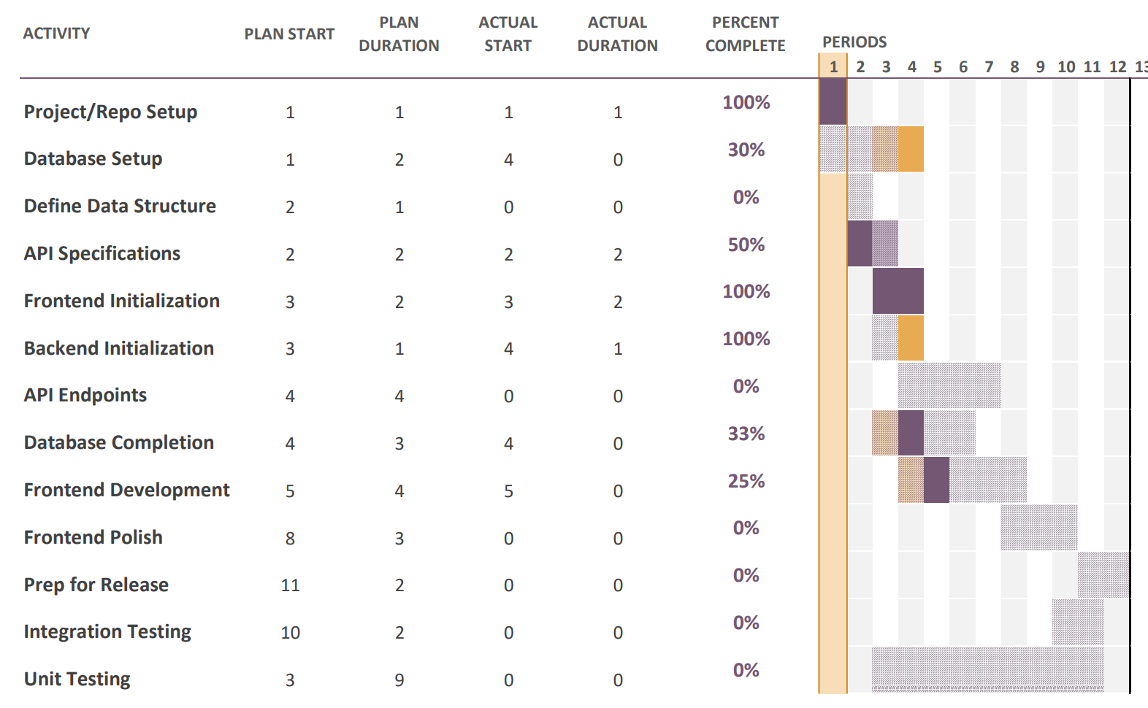
Gantt Chart

Slide 11
Our Future Goals
Improve our landing page by adding default decks and cards
Keep polishing the front-end
Finishing the DataAccess project for reading and writing to the Database
Starting the App project to begin testing controllers and endpoints
Adding the Authentication and Authorization flows to the back end.

